Slide 1
Docker Swarm
Yaroslav K.

Slide 2

Who am I?
Yaroslav Koriavyi
Lead Software Developer at EPAM
Email: Yaroslav_Koriavyi@epam.com
GitHub: https://github.com/YaroslavKoriavyi

Slide 3
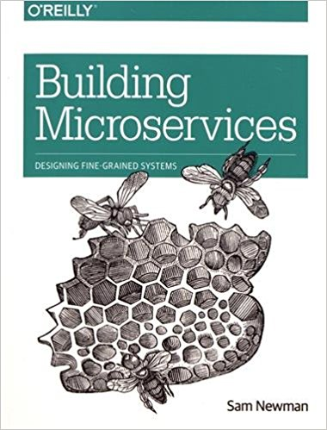
What is a microservice?
Small, and Focused on Doing One Thing Well
Autonomous
Building Microservices by Sam Newman

Slide 4
DOCKER

Slide 5

Docker ecosystem
Docker Engine
Docker Swarm
Docker Registry
Docker Machine
Docker Compose

Slide 6
DOCKER SWARM

Slide 7
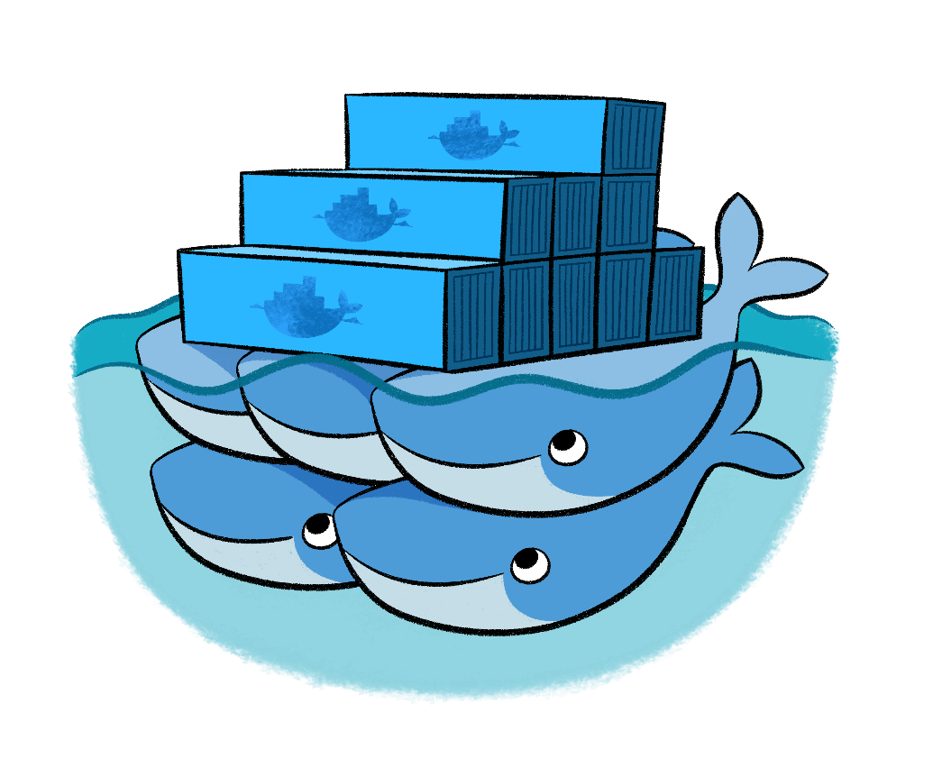
Swarm Features
Highly-available, distributed store based on Raft (Service discovery)
Cluster management integrated with Docker Engine
Declarative service model
Scaling
Desired state reconciliation
Multi-host networking
Load balancing
Secure by default
Rolling updates

Slide 8
Service Discovery
All other orchestration systems use a key/value store (k8s→etcd, nomad→consul, mesos→zookeeper, etc.)
Swarm stores information directly in Raft
Analogy courtesy of @aluzzardi: It's like B-Trees and RDBMS. They are different layers, often associated. But you don't need to bring up a full SQL server when all you need is to index some data.
As a result, the orchestrator has direct access to the data (the main copy of the data is stored in the orchestrator's memory)
Simpler, easier to deploy and operate; also faster

Slide 9
Swarm Concept
A node can be a manager or a worker
A manager actively takes part in the Raft consensus
You can talk to a manager using the Swarm API
One manager is elected as the leader; other managers merely forward requests to it
Using the API, you can indicate that you want to run a service

Slide 10
Swarm Concept
A service is specified by its desired state: which image, how many instances...
The leader uses different subsystems to break down services into tasks: orchestrator, scheduler, allocator, dispatcher
A task corresponds to a specific container, assigned to a specific node
Nodes know which tasks should be running, and will start or stop containers accordingly (through the Docker Engine API)

Slide 11
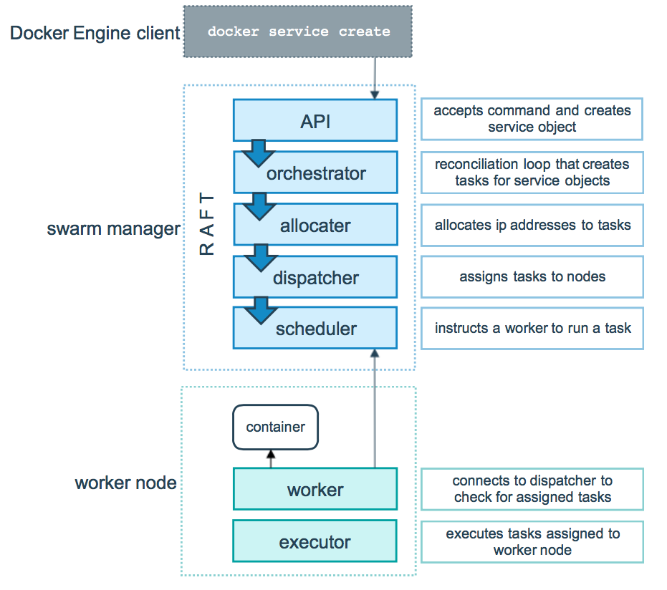

Slide 12
Swarm Mode
The Docker CLI features three new commands:
docker swarm (enable Swarm mode; join a Swarm; adjust cluster parameters)
docker node (view nodes; promote/demote managers; manage nodes)
docker service (create and manage services)

Slide 13
Building swarm cluster

Slide 14
Visualizing the cluster

Slide 15
Adding nodes to the cluster

Slide 16
Security

Slide 17
Under the hood
When we do docker swarm init, a TLS root CA is created. Then a keypair is issued for the first node, and signed by the root CA.
When further nodes join the Swarm, they are issued their own keypair, signed by the root CA, and they also receive the root CA public key and certificate.
All communication is encrypted over TLS.
The node keys and certificates are automatically renewed on regular intervals (by default, 90 days; this is tunable with docker swarm update).

Slide 18
Docker Service

Slide 19
Routing Mesh

Slide 20
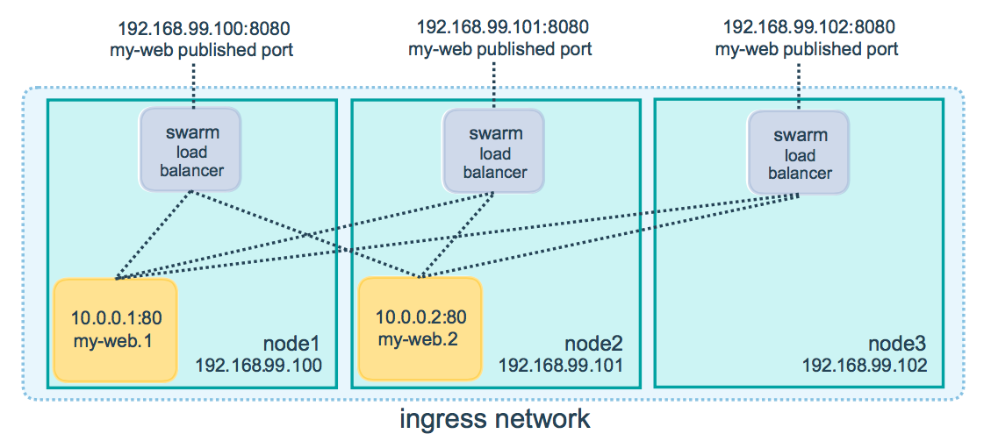
Routing Mesh

Slide 21
Scaling a service

Slide 22
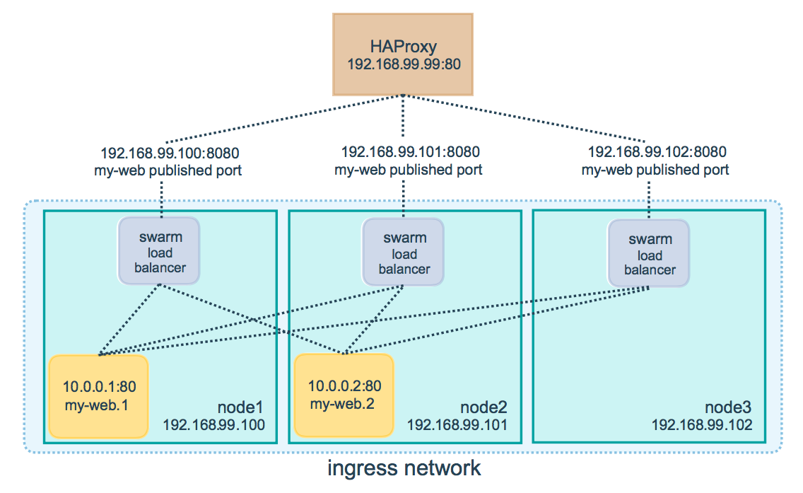
Reverse proxy

Slide 23
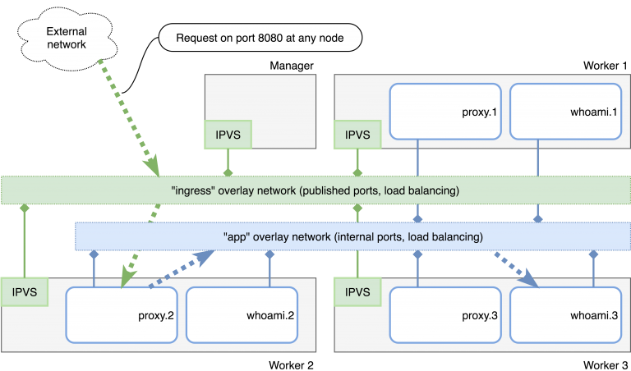

Slide 24
Dockerfile

Slide 25
Rolling Updates

Slide 26
Docker Secrets, service-Configs

Slide 27
Docker System?

Slide 28
What now?

Slide 29
What now?

Slide 30
Metrics
Prometheus
cAdvisor
InfluxDB
etc.

Slide 31
Logging
ElasticSearch, Kibana and Logstash (ELK)
FluentD
Loggly
Graylog
gliderlabs/logspout

Slide 32
Dashboards
Grafana (https://grafana.com/grafana/dashboards/609)

Slide 33
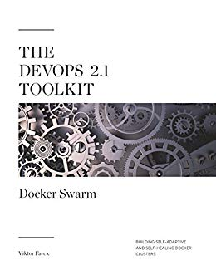
Book
The DevOps 2.1 Toolkit

Slide 34
Questions?
Email: Yaroslav_Koriavyi@epam.com

Slide 35
Thank you Дякую!

